Slide 1

women’s world cup Shiny ApP
University of North Carolina at Charlotte
DSBA 5122 – Fall 2019 Final Project
Presented by Joshua Ganz, Julian Mucha, and Eric Rwabuhihi
December 9, 2019

Slide 2
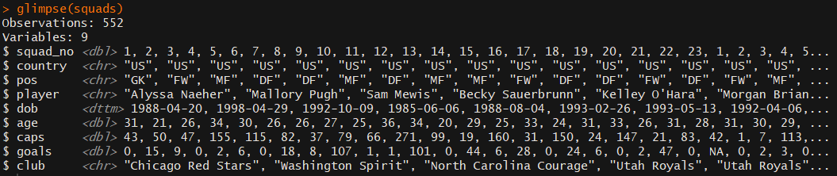
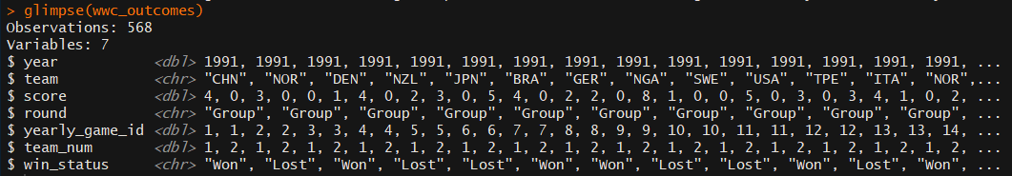

Dataset (Original)

Slide 3
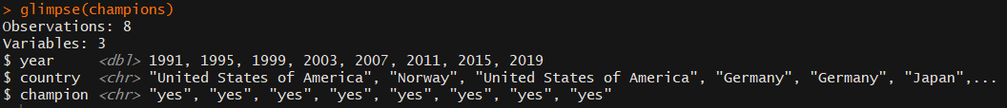
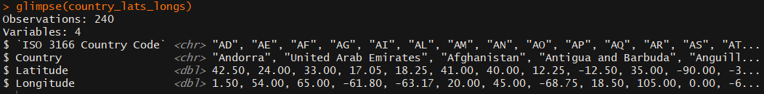
Dataset (added)

Slide 4

App Overview

Slide 5
World Cup Stats

Slide 6
World Cup Stats

Slide 7
World Cup MAP

Slide 8
2019 Roster

Slide 9
About

Slide 10

Thank you
Questions?

